Slide 1




LSTM (long short term memory) Hochreitor & Shmidhuber 1997
Module in RNN
(h_{t} is the same s_{t})
h_{t} =tanh(Ux_{t}+W h_{t-1})
The repeating module in a standard RNN contains a single layer.
Module in LSTM
The repeating module in an LSTM contains four interacting layers.
the LSTM can read, write and delete information from its memory.

Slide 2


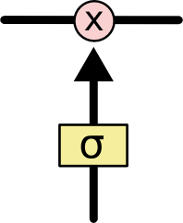
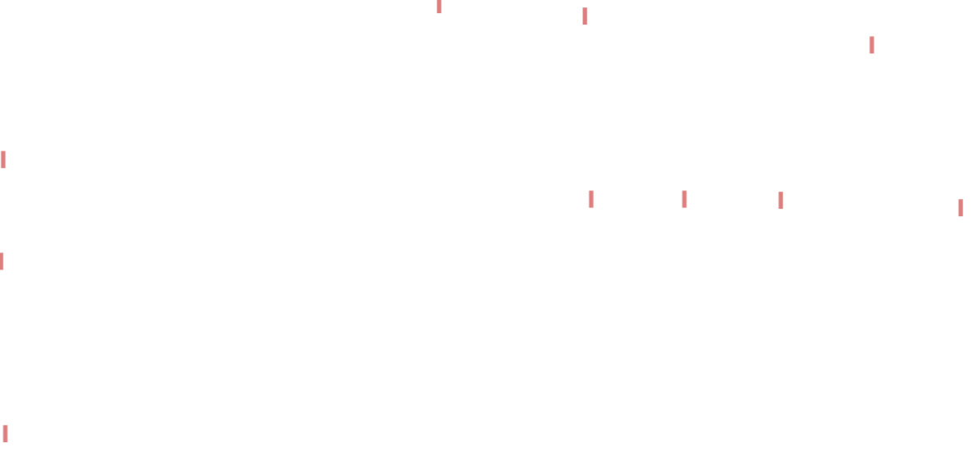
Some Concepts
The notation
Two key concepts in LSTMs
1. Cell state
2. Gate
Gates are a way to optionally let information through.
They are composed out of a sigmoid neural net layer and a pointwise multiplication operation.

Slide 3
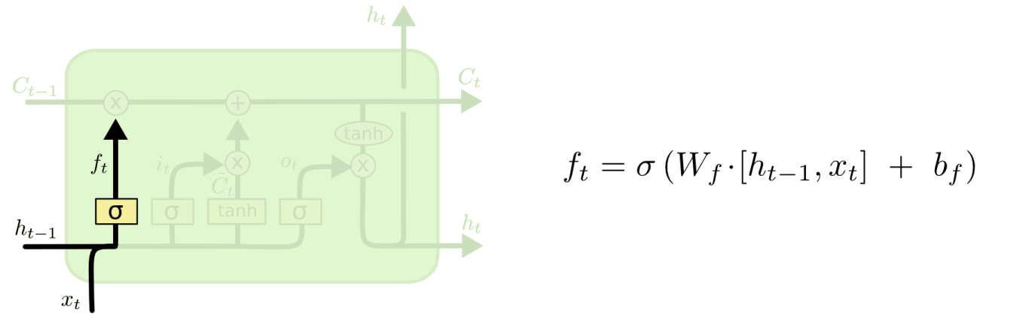

Step-by-Step LSTM Walk Through
Step1: to decide what information we’re going to throw away from the cell state.
A Gate for
Saving/Deleting Memory
Forget Gate

Slide 4


Step2: to decide what new information we’re going to store in the cell state.
A Gate for Writing to Memory
Input Gate

Slide 5


Step3: drop the information about the old subject’s gender and add the new information, as we decided in the previous steps.
Deleting/Saving and Writing to Memory

Slide 6


Step4: to decide what we’re going to output
Reading from Memory
Output Gate

Slide 7
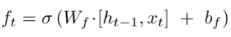
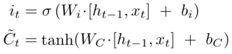
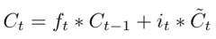
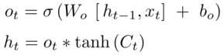

Compact Form Equations

Slide 8
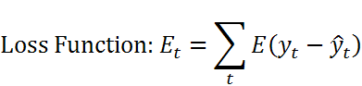
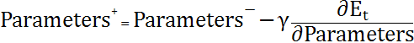

Parameters are updated by “BPTT” All computed gradients of parameters are added together through the time

Slide 9
LSTM Learning methods
Like RNN, “BPTT” can be performed to learn the weights and biases of a LSTM module. Unlike standard RNNs, the error remains in the unit's memory.
LSTM can also be trained by a combination of artificial evolution for weights to the hidden units, and pseudo-inverse or support vector machines for weights to the output units.
In reinforcement learning applications LSTM can be trained by policy gradient methods, evolution strategies or genetic algorithms.

